Slide 1
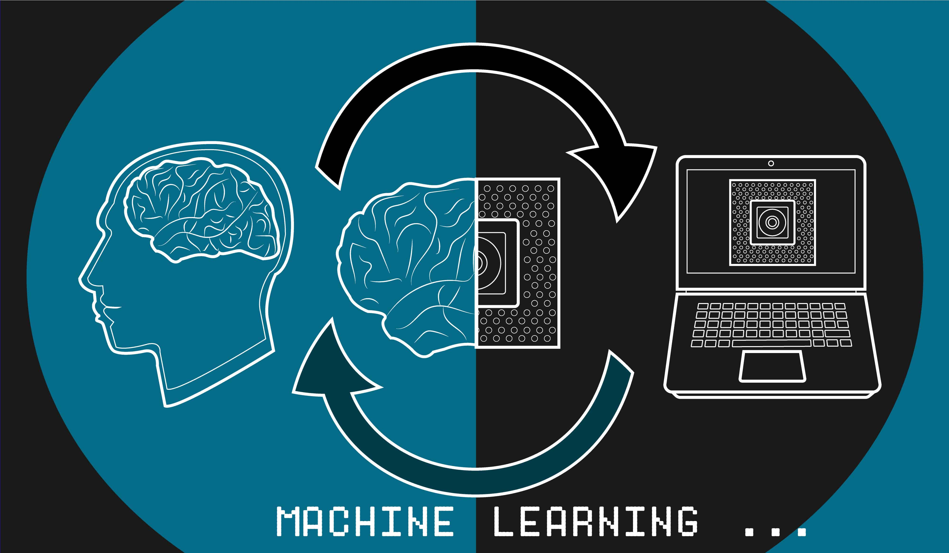

Brain Stroke Prediction Using Machine Leaning and Data Science

Slide 2
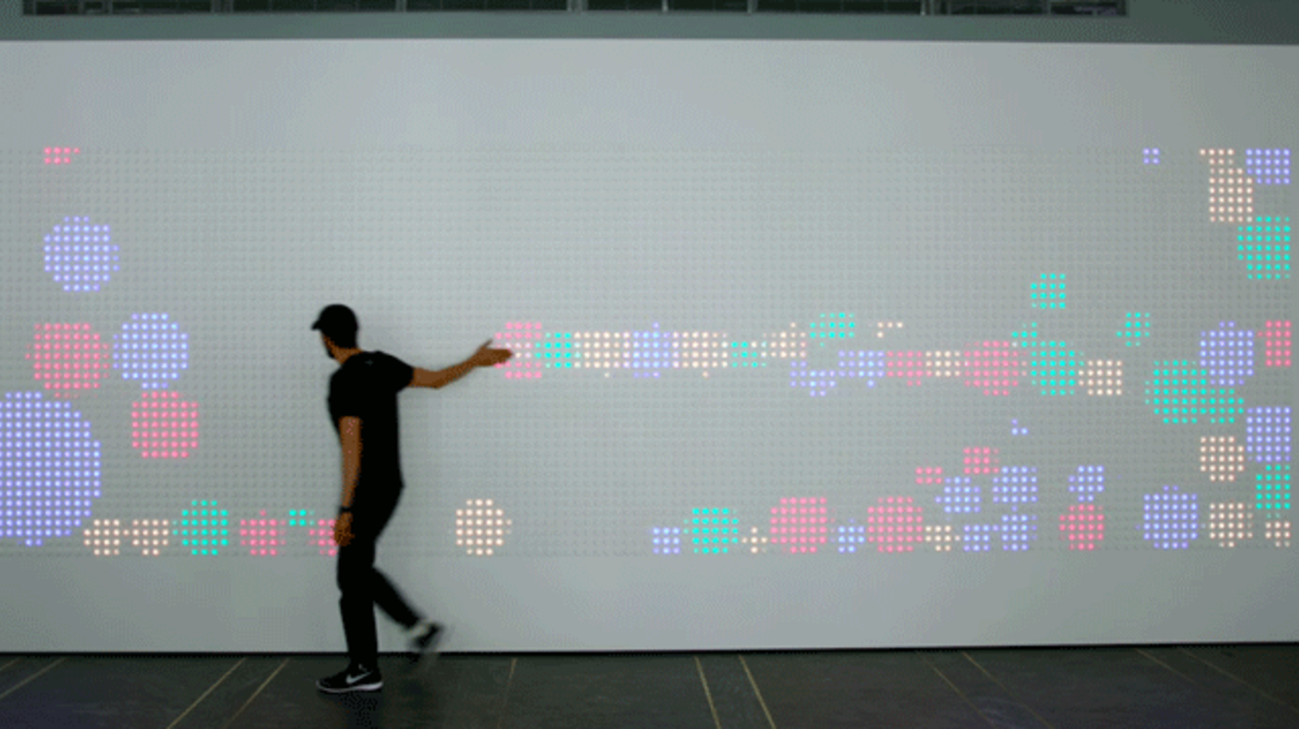
MODEL COMPARISION
Preventive
Measures
Potential Benefits
Solution Process
Key Findings
Recommendation
Problem Overview
AGENDA

Slide 3

Problem Overview
What is the problem?
We will examine who is effected by this problem?
how we can decrease the chances of getting this problem by some preventive measures?
In the next steps we will see how we can use our insights in the business domain.

Slide 4
The Problem is Brain Stroke? Brain Stroke occurs when a part of brain loses its blood supply and stops working. It is also called as Cerebrovascular accident. People with age > 60 are affected more, when compared with age groups of 15-59. This Problem can be overcome using: 1.Proper Healthcare Diagnostics 2.Innovative use of Technology 3.Spreading Awareness about the Disease and Treatment.

Slide 6




Solution Process
Model Validation
Model Performance measure on
testing data
Dataset provided by the xyz?, dataset has ? observation and ? features. Explanation of the dataset like columns types demographic, history etc
STEP
04
Model Preparation
We teach the model
on Training dataset,
STEP
03
Analytical approach
Supervised Machine Learning problem,
Two class Classification,
STEP
02
Analyse Data
Heterogeneous population, Anomaly Treatment, Missing Values Treatment, creating new variable
STEP
01

Slide 7
MODELS COMPARISION
MODEL 2
MODEL 3
MODEL 1
Training | Testing
100% | 81%
100% | 21%
100% | 86%
100% | 52%
Training | Testing
84% | 86%
60% | 50%
84% | 86%
68% | 69%
Training | Testing
84% | 86%
71% | 66%
84% | 86%
73% | 71%
Accuracy
“CHD” Correct Prediction
“non-CHD” Correct Prediction
Performance

Slide 8







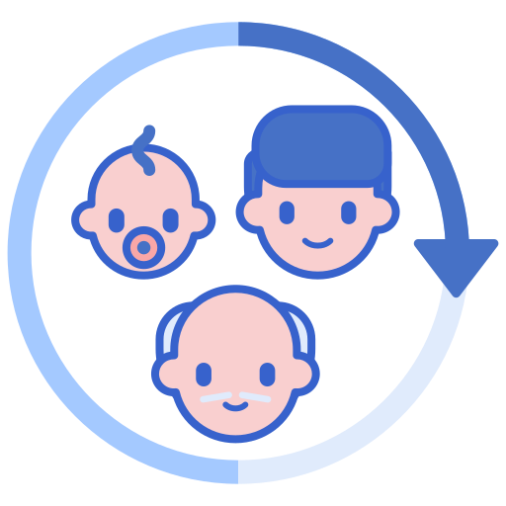
Key Insights
The most important factors that influence the problem
Feature 1
Feature 8
Feature 2
Feature 7
Feature 3
Feature 6
Feature 4
Feature 5

Slide 9
Preventive 5
Preventive 2
Preventive 3
Preventive 4
Preventive 1
Preventing Measures

Slide 10
Recommendation
Recommendation 1
Explain the recommendation
Recommendation 2
Explain the recommendation
Recommendation 3
Explain the recommendation
Recommendation 4
Explain the recommendation

Slide 11

Benefits 1
Benefits 2
Benefits 3
Potential Benefits
50.9 Billion
Dollar

Slide 12

QA?

